Slide 1

WEB TECHNOLOGIES
Web Development Stack
Prof. Vinay Joshi and Prof. Sindhu R Pai
Department of Computer Science and Engineering

Slide 2



React.JS
Introduction

Slide 3
React.JS
Introduction
What is React?
React is a declarative, efficient, and flexible JavaScript library for building user interfaces. It lets you compose complex UIs from small and isolated pieces of code called “components”.
React is a tool for building UI components.
ReactJS is a declarative, efficient, and flexible JavaScript library for building reusable UI components.
It is an open-source, component-based front end library which is responsible only for the view layer of the application. It was initially developed and maintained by Facebook and later used in its products like WhatsApp & Instagram.

Slide 4
React.JS
Introduction
An open-source JavaScript library used for building user interfaces specifically for single-page applications.
Handles the view layer for web and mobile apps.
Allows developers to create large web applications that change dynamically, without the need of reloading.
Allows to create reusable UI components.
Works only on user interfaces in the application.
First created by Jordan Walke, a software engineer working for Facebook. First deployed on Facebook’s newsfeed in 2011 and on Instagram.com in 2012.

Slide 5
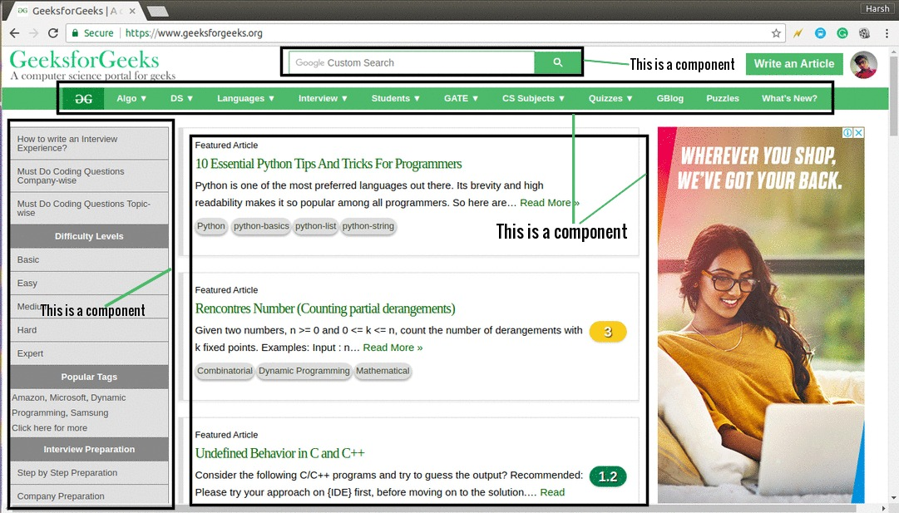
React.JS
Introduction

Slide 6
React.JS
Introduction
Why we use ReactJS?
The main objective of ReactJS is to develop User Interfaces (UI) that improves the speed of the apps.
It uses virtual DOM (JavaScript object), which improves the performance of the app.
The JavaScript virtual DOM is faster than the regular DOM.
We can use ReactJS on the client and server-side as well as with other frameworks.
It uses component and data patterns that improve readability and helps to maintain larger apps.

Slide 7
React.JS
Introduction
Why learn ReactJS?
DOM is an object which is created by the browser each time a web page is loaded.
It dynamically adds or removes the data at the back end and when any modifications were done, then each time a new DOM is created for the same page.
This repeated creation of DOM makes unnecessary memory wastage and reduces the performance of the application.

Slide 8
React.JS
Introduction
Therefore, a new technology ReactJS framework invented which remove this drawback. ReactJS allows you to divide your entire application into various components.
ReactJS still used the same traditional data flow, but it is not directly operating on the browser's Document Object Model (DOM) immediately;
instead, it operates on a virtual DOM. It means rather than manipulating the document in a browser after changes to our data, it resolves changes on a DOM built and run entirely in memory.

Slide 9

React.JS
Introduction

Slide 10
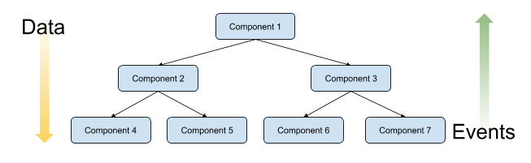
React.JS
Why React?
Properties
Declarative, Simple, Component based, Supports server side, Mobile support, Extensive, Fast , Easy to learn
Single way data flow
In React JS we cannot make any change to a component directly if needed we provide a callback.
Actions flow up and properties flow down
The property of passing a value in the component and rendering it as HTML tags properties

Slide 11
React.JS
Why React?
Virtual DOM
React maintains a in-memory copy of the actual DOM known as the virtual DOM
Manipulating this virtual DOM is extremely fast
React takes care of updating the real DOM when the time is right
Compares the changes between your virtual DOM and the real DOM
Figuring out which changes actually matter, and making the least amount of DOM changes

Slide 12

React.JS
How to create a React App?
Two ways:
Using node package manager(npm):
To setup a build environment for React involves use of npm (node package manager), webpack, and Babel
Directly importing Reactjs library in HTML Code.
Defined in two .js files (React and ReactDOM)
<script src="https://unpkg.com/react@17/umd/react.development.js" crossorigin></script>
<script src="https://unpkg.com/react-dom@17/umd/react-dom.development.js" crossorigin> </script>
The files differ for development and production.
When deploying, replace "development.js" with "production.min.js”

Slide 13
React.JS
What is JSX?(JAVASCRIPT XML)
JavaScript Extension Syntax used to mix HTML with JavaScript
Uses HTML syntax to create elements and components.
Has tag name, attributes, and children.
JSX compiles the code into pure JavaScript which can be understood by the browser.
Include the library: <script src="https://unpkg.com/babel-standalone@6.15.0/babel.min.js"> </script>
<script type="text/babel">
ReactDOM.render(<h1>Welcome to REACTJS</h1>,
document.getElementById('root'));

Slide 14
React.JS
React JSX
JSX(JavaScript Extension), is a React extension which allows writing JavaScript code that looks like HTML
JSX stands for JavaScript XML.
JSX allows us to write HTML in React.
JSX makes it easier to write and add HTML in React.

Slide 15
React.JS
JSX
JSX allows us to write HTML elements in JavaScript and place them in the DOM without any createElement() and/or appendChild() methods.
JSX converts HTML tags into react elements.
const myelement = <h1>I Love JSX!</h1>;
ReactDOM.render(myelement, document.getElementById('root'));
JSX allows us to write HTML directly within the JavaScript code.
JSX is an extension of the JavaScript language based on ES6, and is translated into regular JavaScript at runtime.

Slide 16
React.JS
ReactDOM.Render
React's goal is in many ways to render HTML in a web page.
React renders HTML to the web page by using a function called ReactDOM.render().
The ReactDOM.render() function takes two arguments, HTML code and an HTML element.
The purpose of the function is to display the specified HTML code inside the specified HTML element.
But render where?
You'll notice a single <div> in the body of this file. This is where our React application will be rendered

Slide 17
React.JS
JSX
ReactDOM.render(<p>Hello</p>, document.getElementById('root’));
The result is displayed in
<body>
<div id="root"></div>
</body>

Slide 18
React.JS
JSX
Create a variable that contains HTML code and display it in the "root" node:
const myelement = (
<table>
<tr>
<th>Name</th>
</tr>
<tr>
<td>John</td>
</tr>
<tr>
<td>Elsa</td>
</tr>
</table>
);
ReactDOM.render(myelement, document.getElementById('root'));

Slide 19
React.JS
EXAMPLE
<html>
<head>
<script src="https://unpkg.com/react@17/umd/react.development.js" crossorigin></script>
<script src="https://unpkg.com/react-dom@17/umd/react-dom.development.js" crossorigin></script>
<script src="https://unpkg.com/@babel/standalone/babel.min.js"></script>
</head>
<body>
<div id="mydiv"></div>
<script type="text/babel">
function Hello() {
return <h1>Hello World!</h1>;
}
ReactDOM.render(<Hello />, document.getElementById('mydiv'))
</script>
</body>
</html>

Slide 20
React.JS
JSX
With JSX you can write expressions inside curly braces { }.
The expression can be a React variable, or property, or any other valid JavaScript expression. JSX will execute the expression and return the result:
const myelement = <h1>React is {5 + 5} times better with JSX</h1>;

Slide 21
React.JS
JSX
Inserting a Large Block of HTML
To write HTML on multiple lines, put the HTML inside parentheses:
const myelement = (
<ul>
<li>Apples</li>
<li>Bananas</li>
<li>Cherries</li>
</ul>
);
ReactDOM.render(myelement, document.getElementById('root'));

Slide 22
React.JS
JSX
One Top Level Element
The HTML code must be wrapped in ONE top level element.
So if you like to write two paragraphs, you must put them inside a parent element, like a div element.
Example
Wrap two paragraphs inside one DIV element:
const myelement = (
<div>
<p>I am a paragraph.</p>
<p>I am a paragraph too.</p>
</div>
);

Slide 23
React.JS
JSX
Elements Must be Closed
JSX follows XML rules, and therefore HTML elements must be properly closed.
const myelement = <input type="text" />;
ReactDOM.render(myelement, document.getElementById('root'));

Slide 24
React.JS
Demonstration
1. ReactDOM.render(<h1>Batman</h1>,document.body);
2. <body>
<div id="container"></div>
<script type="text/babel">
ReactDOM.render( <h1>Batman</h1>,document.querySelector("#container"));
3. var destination = document.querySelector("#container");
ReactDOM.render(
<h1>Batman</h1>,
destination
);

Slide 25
React.JS
Components
Components are like functions that return HTML elements.
React Components
Components are independent and reusable bits of code.
They serve the same purpose as JavaScript functions, but work in isolation and return HTML.
Components come in two types, Class components and Function components

Slide 26
React.JS
React Component
A user control that has code to represent visual interfaces and data
An isolated piece of code which can be reused in one or the other module
Contains a root component in which other subcomponents are included
2 types of components in React.js
Stateless Functional Component
Stateful Class Component

Slide 27
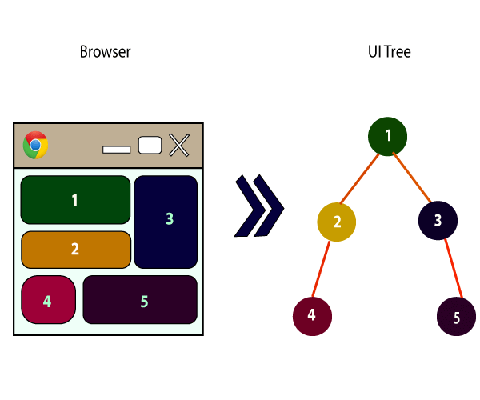
React.JS
Components
Components are part of UI together will make whole UI
Components are Reusable
Components can contain other components

Slide 28
React.JS
Function Component
Function Component
A Function component also returns HTML, and behaves much the same way as a Class component,
but Function components can be written using much less code, are easier to understand,
Functional components are simply javascript functions.
We can create a functional component in React by writing a javascript function.
These functions may or may not receive data as parameters
Example
Create a Function component called Car
function Car() {
return <h2>Hi, I am a Car!</h2>;
}

Slide 29
React.JS
Props
Properties
Components can be passed as props, which stands for properties.
Props are like function arguments, and you send them into the component as attributes.
function Car(props) {
return <h2>I am a {props.name} Car!</h2>;
}
ReactDOM.render(<Car name=“kia"/>, document.getElementById('root'));

Slide 30
React.JS
Class Component
Class Component
When creating a React component, the component's name MUST start with an upper case letter.
All class based components are child classes for the Component class of ReactJS. Class Component
A class component must include the extends React.Component statement. This statement creates an inheritance to React.Component, and gives your component access to React.Component's functions.
The component also requires a render() method, this method returns HTML.
Example
Create a Class component called Car
class Car extends React.Component {
render() {
return <h2>Hi, I am a Car!</h2>;
}
}

Slide 31
React.JS
Class Component
Once a component is declared, it can be used in other components. Program to demonstrate the use of class based components in other components.
class Sample extends React.Component {
render() {
return <h1>A Computer Science Portal</h1>;
}
}
class App extends React.Component {
render() {
return <Sample />;
}
}

Slide 32
React.JS
Introduction
Rendering a Component
Now your React application has a component called Car, which returns an <h2> element.
To use this component in your application, use similar syntax as normal HTML: <Car />
Example
Display the Car component in the "root" element:
ReactDOM.render(<Car />, document.getElementById('root’));
function Welcome() {
return <h2>Hi Welcome!</h2>;
}
ReactDOM.render(<Welcome />, document.getElementById('root'));

Slide 33
React.JS
Difference between Functional and Class Components
For now, keep in mind that we will use functional component only when we are sure that our component does not require interacting or work with any other component.
That is, these components do not require data from other components however we can compose multiple functional components under a single functional component.
Stateless Components
We can also use class-based components for this purpose but it is not recommended as using class-based components without need will make your application in-efficient.
State-Full Components

Slide 34
React.JS
React Component Example codes
Stateless Functional Component
function Demo(props) {
return <h1> Welcome to REACT JS, {props.Name} </h1>;
}
Stateful Class Component
class HelloClass extends React.Component
{ render()
{ return React.createElement(‘h1’, null, ’welcome to REACT JS’); }
}
class Demo extends React.Component{
render(){
return <h1> Welcome to REACT JS, {props.Name} </h1>; }
}

Slide 35
React.JS
Demonstration
Component Constructor
If there is a constructor() function in your component, this function will be called when the component gets initiated.
The constructor function is where you initiate the component's properties.
In React, component properties should be kept in an object called state.
The constructor function is also where you honor the inheritance of the parent component by including the super() statement, which executes the parent component's constructor function,
and your component has access to all the functions of the parent component (React.Component).

Slide 36
React.JS
Demonstration
class Car extends React.Component {
constructor() {
super();
this.state = {color: "red"};
}
render() {
return <h2>I am a {this.state.color} Car!</h2>;
}
}

Slide 37
React.JS
Demonstration
Props in the Constructor
If your component has a constructor function, the props should always be passed to the constructor and also to the React.Component via the super() method.
Example
class Car extends React.Component {
constructor(props) {
super(props);
}
render() {
return <h2>I am a {this.props.model}!</h2>;
}
}
ReactDOM.render(<Car model="Mustang"/>, document.getElementById('root'));

Slide 38
React.JS
Components in Components
Components in Components
class Car extends React.Component {
render() {
return <h2>I am a Car!</h2>;
}
}
class Garage extends React.Component {
render() {
return (
<div>
<h1>Who lives in my Garage?</h1>
<Car />
</div>
);
}
}
ReactDOM.render(<Garage />, document.getElementById('root'));

Slide 39
React.JS
Visuals Defined using JSX vs Pure JavaScript
JSX
JavaScript
ReactDOM.render(
<div>
<h1>Batman</h1>
<h1>Iron Man</h1>
<h1>Nicolas Cage</h1>
<h1>Mega Man</h1>
</div>,
destination );
ReactDOM.render(
React.createElement ( "div", null,
React.createElement ( "h1", null, "Batman" ),
React.createElement ( "h1", null, "Iron Man" ),
React.createElement ( "h1", null, "Nicolas Cage" ),
React.createElement ( "h1", null, "Mega Man" ),
destination);

Slide 40
React.JS
React Component – Few key terms
Placeholder: A place where the component will load
Create component: Stateless or stateful
Call Component: ReactDOM.render() is responsible for rendering a React component.
The first parameter: is a component class name.
Second parameter: is the destination where the component is to be rendered.
In our case, we render component inside the div id=‘root’.
Example: ReactDOM.render(
React.createElement(HelloClass, null, null),
document.getElementById('root'));

Slide 41
React.JS
What is Babel?
A JavaScript compiler that can translate markup or programming languages into JavaScript.
Available for different conversions.
React uses Babel to convert JSX into JavaScript.
Please note that <script type="text/babel"> is needed for using Babel
<script type="text/babel">
ReactDOM.render(<h1>Welcome to REACTJS</h1>,
document.getElementById('root')
);

Slide 42
React.JS
Demonstration
Using React, print welcome to REACTJS on the web page
Use JSX and NonJSX both

Slide 43
THANK YOU
Vinay Joshi and Sindhu R Pai
Department of Computer Science and Engineering
vinayj@pes.edu
+91 8026726622
sindhurpai@pes.edu
+91 8277606459

